Slide 1
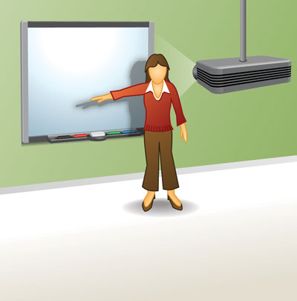
ASD Awareness
ASD?

Slide 2

Learning Intentions
Today we hope to:
Develop an awareness of Autism Spectrum Disorder and the associated difficulties.
Sensory
Triad of Impairments
Notes:
One learning intention per session if you are breaking it down into four sessions.

Slide 3

Fact or Myth?
1 1. Autism affects more than 1 in 100 people.

Slide 4
FACT
Over 700,000 people in UK are diagnosed with ASD, which means that 2.8m people have a relative on the autism spectrum.
Over 30,000 people in NI with a diagnosis

Slide 5
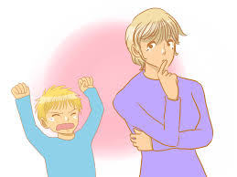
Fact or Myth?
2.People tend to 'grow out' of autism in adulthood

Slide 6
MYTH
It's a lifelong condition – children with autism become adults with autism.

Slide 7
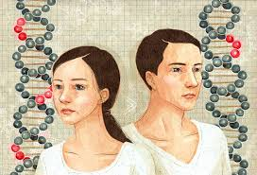
Fact or Myth?
3. Autism affects both boys and girls

Slide 8
FACT
There is a popular misconception that autism is simply a male condition. This is false.

Slide 9
Fact or Myth?
4. Some people with autism don’t speak

Slide 10
FACT
Some people with autism are non-verbal and communicate through other means. However, autism is a spectrum condition, so everyone’s autism is different.

Slide 11
Fact or Myth?
6. All people with autism are geniuses

Slide 12
MYTH
Just under half of all people with an autism diagnosis also have a learning disability. Others have an IQ in the average to above average range. 'Savant' abilities like extraordinary memory are rare.

Slide 13
Fact or Myth?
7. Everyone has autism

Slide 14
MYTH
While everyone might recognise some autistic traits or behaviours in people they know, to be diagnosed with autism, a person must consistently display behaviours across all the different areas of the condition. Just having a fondness for routines, a good memory or being shy doesn’t make a person 'a bit autistic'.

Slide 15

 | 2008/09 | 2018/19
The autism prevalence rate: | 1.2% | 3.3%
The autism prevalence rate for males: | 1.9% | 5.1%
The autism prevalence rate for females: | 0.4% | 1.5%
Department of Health The Prevalence of Autism (including Asperger Syndrome) in School Age Children for Northern Ireland 2019
Autism Advisory and Intervention Service

Slide 16
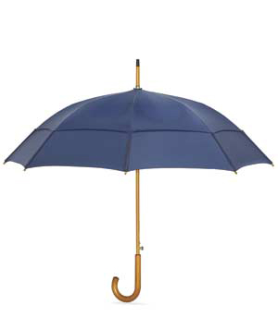
The Autism Spectrum
Autism
Asperger's Syndrome
Autism Advisory and Intervention Service
Notes:
Autism and Asperger’s Syndrome is defined within the term Autism Spectrum now.
Seen as a spectrum disorder, encompassing classic autism and Asperger’s syndrome
Autism Spectrum Disorder (ASD) is a:
spectrum condition
lifelong condition, with no cure and no known cause
condition that impacts on social interaction, communication, imagination and flexibility of thought
condition that may include sensory sensitivities.
Pervasive condition IMPACTS ON EVERY AREA of a childs life i.e.
like a different culture
see things differently
situations differently
impacts on all areas of daily living

Slide 17
“The Difference Between Us…”
(Harold Stone)
Autism Advisory and Intervention Service
Notes:
Harold Stone, an Australian diagnosed with Autism explains:
"You are cars. You run on roads. You go this way and that way. You see a roadblock and immediately, you know another way to go. Sometimes you take the scenic route home, other times you take the more direct route. You are full of options.”
“We are trains. We run on a single track. We consider one route at a time. If you understood that we were trains you could help us find our track among your system of roads“

Slide 18

The ‘Whole Child’
Strengths
Strong visual ability
Technical ability
Ability to focus when interested in subject
Detailed factual knowledge
Strong memory & rote learning skills
Truthful and honest
Impairments
Social Interaction
Social Communication
Social Imagination
Sensory Issues
Associated Difficulties

Slide 19
The Triad of Impairments
Wing and Gould, 1979
Social Interaction
Triad of Impairments
Social Communication
Social Imagination & Rigidity of Thought
Notes:
Wing and Gould (1979) coined the phrase “Triad of Impairments” to define those on the Autism Spectrum, meaning that those who are diagnosed as being on the Autism Spectrum have difficulties in three specific areas, namely, Social understanding, social communication and rigidity of thought. These difficulties are experienced by all who have a diagnosis of Autism and for some, these will present more severely than in others. The DSM V diagnostic criteria has also suggested that all those with Autism will also have difficulties with sensory processing, meaning that they may have a hypo or hyper reactivity to sensory input. (Wing.L.& Gould J(1979)Journal of Autism and developmental disorders 9,1)
In the case of autism these difficulties may be severe and may also be associated with learning difficulties.
Asperger's Syndrome is characterised by the same triad of impairments as autism but without significant learning or structural language difficulties (clumsiness is often associated with the condition).

Slide 20
The Triad of Impairments?
The Triad of Impairments consists of three areas of difficulty which all people with autism share:
Social Interaction: understanding how to behave and interact with other people
Communication: the ability to communicate effectively with other people
Imagination & flexibility of thought: deficits in flexible thinking regarding interest, routines, perspectives and rules. May have difficulty coping with new, unfamiliar or unexpected situations.
Notes:
In order to receive a diagnosis the individual must have a certain number of impairments in all three areas.
These may present differently in each pupil
We will not look at each of these three areas and their impact on teaching, learning and the wider school environment

Slide 21
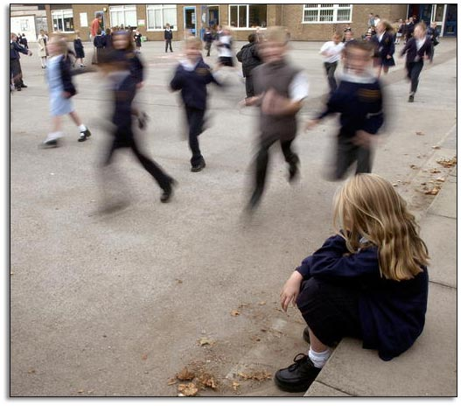
Impaired Social Interaction
Difficulty making and keeping friends. Often a solitary player/very withdrawn
Simple social actions are often a complicated process (lining up, personal space, dialogue)
Difficulty in understanding different social situations

Slide 22
Impaired Social Interaction
Find it difficult to understand the thoughts and feelings of others (Theory of Mind)
May not cope in a group
Difficulty with sharing or taking turns
Notes:
Each of the elements of the Triad of Impairments presents a range of educational implications which you may see in your classroom. For example, with regards to social interaction, this may present as the individual having a low tolerance of their peer group or having difficulty taking turns. If there is a young person in your class who is unaware of how to behave appropriately in a social situation this may also be due to difficulties with social interaction. Further educational implications include showing little desire to investigate, having reduced empathy for others, appearing socially aloof or awkward and having restricted interests. Some of the more common restricted interests may include Thomas the Tank, Pokémon, Horses, Frozen, the IPad etc, however it is not limited to these as some children with ASD have restricted interests in other things such as hoovers or maps.
Differences in social interaction can also lead to difficulties when it comes to performing simple social actions such as asking to join in to play a game or lining up. It is however, important to bear in mind that with the correct strategies, young people with Autism can be taught how to manage effectively in social situations.

Slide 23

Impaired Social Communication
Varying expressive language abilities
Varying receptive language abilities
Delayed and/or immediate echolalia
Notes:
Varying Expressive Language:
Non-verbal – verbal. Not their ability to speak but more importantly their understanding (receptive)
Varying Receptive Language:
Their ability to understand. Be cautious about their spoken language and don’t assume they understand!
Delayed/Immediate Echolalia:
Repetitive speech – immediate/delayed

Slide 24
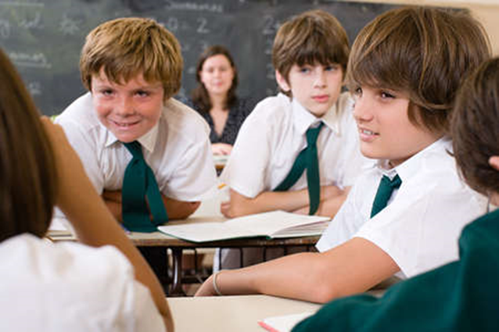
Impaired Social Communication
Unusual voice characteristics e.g. volume, tone, accent
Difficulty with social aspects of language
Manipulates conversation to topic of interest
Notes:
As with the differences in social interaction, many children with ASD may display a number of differences in social communication which you may see in your classroom. For example, it may lead to difficulties in understanding simple instructions and having a lack of motivation to communicate. It is important to remember that the child with ASD will not necessarily be motivated by something that we think they should be motivated by. It is important to get to know the individual child. Children with difficulties in social communication may also have a limited understanding of the attempts of others and may not enjoy social situations and they may also find it difficult to understand the non verbal cues of their peers and / or adults. Those with autism can also, at times, manipulate conversations around to their topic of interest and can also have great difficulty in understanding the non verbal cues that we use every day in our communication with others.

Slide 25
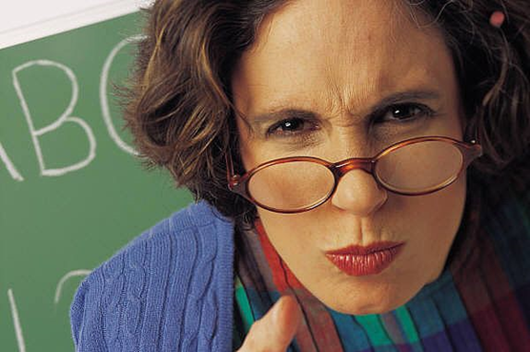
Impaired Social Communication
May not read or understand facial expression, gesture, body language or vocal intonation
Literal interpretation of language (idioms, sarcasm)
Notes:
May not read or understand facial expression....:
Difficulties with the non-verbal communication
Literal Interpretation:
May take the meaning exactly as you say – ‘raining cats and dogs’, ‘pull your socks up’
May not understand jokes, sarcasm.
Be careful how you make requests – e.g. “can you put your books away?” They can interpret as a question and don’t necessarily read that you are politely asking them to put their books away!

Slide 26
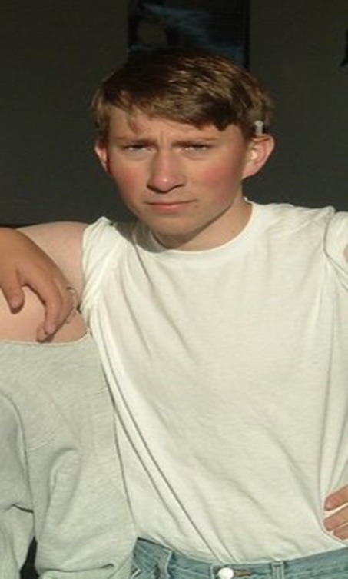
ASD Website - www.wrongplanet.net
Profile Page
  Name: Alex Plank
  Age: 14
  Height: 5 feet 7 inches
  Eyes: blue
  Hair: blonde
  Build: athletic
Notes:
An example of an online dating site for individuals with ASD.
Alex is fine with the factual type information
Read out

Slide 27
Four things I can't live without: breathing, eating, sleeping, exercise
Ideal match: one that lights up right away, without needing to strike it again. (Obviously wooden, not paper ones that come in those cheap matchbooks you get from Chinese restaurants)
Perfect first date: January 1st
Notes:
An example of literal interpretation!

Slide 28
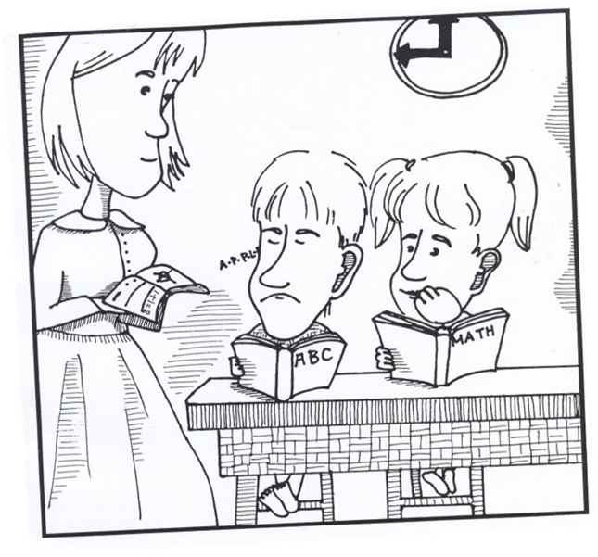
Impairment of Social Imagination
Difficulty with Change
  We have a substitute teacher today. I hate substitutes because they never know what to do. At 9 o’clock she told us to get out our maths books. Everyone knows that 9 o’clock is spelling time so I refused to get out my maths book.
    This is Autism.
Notes:
Difficulty with change:
Find change difficult, example substitute teacher

Slide 29
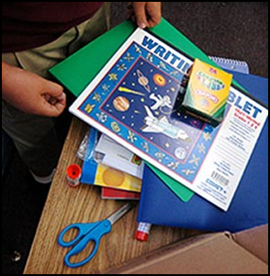
Impairment of Social Imagination
Difficulty with sequencing, organisation, cause
and effect (Executive Functioning)
May have difficulty playing ‘let’s pretend’ games
May display unusual mannerisms/vocalisations
Notes:
Difficulty with Sequencing...:
Find it difficult to order, sequence day to day activities
Let’s Pretend Games:
Unless they have experience can find it difficult to play let’s pretend
Unusual Mannerisms/vocalisations:
At times can display tip toe walking, hand flapping, hands over ears (linked to sensory issues)

Slide 30
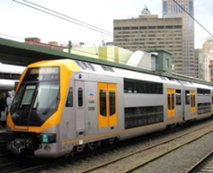
Impairment of Social Imagination
Repetitive / restricted behaviour
Limited range of imaginative activities i.e. special interests and obsessions
Difficulty in creative writing tasks – may need concrete or real-life examples
Focus on irrelevant information without seeing the ‘big picture’ (Central Coherence Theory)
Notes:
You may see difficulties in children in your classroom which may be presenting due to differences in the rigidity of their thoughts and behaviour in the following areas:
Finds pretend play/drama/role play difficult
Unable to use imagination to create models or pictures – images are derived from others
Encounters problems in social games – turn–taking, winning, a draw
Play can be repetitive (rather than using imagination and coming up with a new game or activity) and spontaneity may be limited.
May imitate behaviour but not necessarily for the reason one would expect
Difficulties judging the cause and effect of their own behaviour
Black and white rigid views, difficulties with sarcasm and may have literal understanding of things. Eg the red table please line up.
However, there are lots of strategies that can be put in place to help children with ASD learn things that other children just seem to know and we will look at these after the break.

Slide 31
Sensory
Sensory
Social Interaction
Triad of Impairments
Social Communication
Social Imagination & Rigidity of Thought

Slide 32
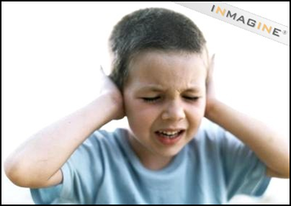
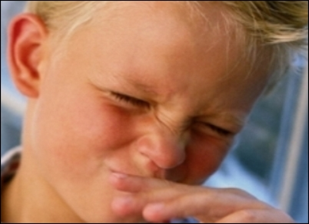
Sensory Sensitivities
Hypersensitivity and/or hyposensitivity
  Visual - Sight
  Auditory - Hearing
  Gustatory - Taste
  Olfactory - Smell
  Tactile - Touch
  Vestibular - Movement, balance and gravity
  Proprioception - Body position
  Interception - The feelings inside
Notes:
Children with autism may also have hyper or hypo reactivity to sensory output.
Tony Attwood states that “Some adults with Asperger's syndrome consider their sensory sensitivity has a greater impact on their daily lives than problems with making friends, managing emotions and finding appropriate employment” (The complete guide to Asperger’s Syndrome)
When we talk about our senses, we have the five which we teach young children about, however there are also other senses which affect us on a daily basis.
Vision - seeing
Hearing -perceiving sounds
Vestibular -structures in inner ear/movement
Olfaction -smell
Gustation -taste
Tactile -touch, pressure , pain and temperature
Proprioceptive -position and movement of body
Interception – the feelings inside
If you think about a school environment, there are many areas which are highly sensory such as they assembly hall, corridors, school bell and dinner hall. I am sure you can think of many others. (PE, carpet time, personal space, toilets etc.)
For children with ASD it affects their inability to filter, balance and integrate the sensory input they receive i.e. they become bombarded with too much stimuli which they cannot process effectively into a coherent understanding of their environment (Hanbury, 2012) This is further demonstrated in the video clip which you are going to watch next.

Slide 33
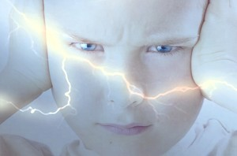
Associated Difficulties
Overly sensitive to loud noises, light, smells and touch.
Bumps into people in line.
Problems with handwriting
Has difficulty paying attention
Always “on the go”
Picky eater
Only likes certain types of clothing
Clumsy
Has difficulty with hair washing and brushing

Slide 34
Other challenges
Sleeping and eating difficulties
Difficulty developing independence
Fears and phobias
Poor spatial awareness and poor motor skills
Limited awareness of danger
Heightened anxiety

Slide 35

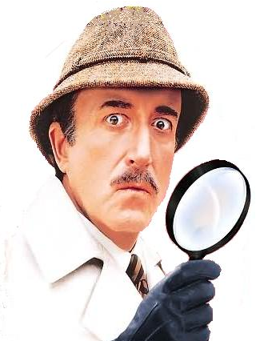

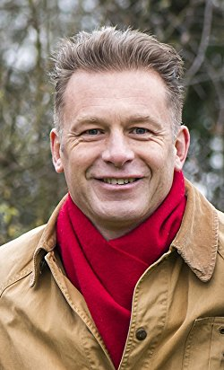
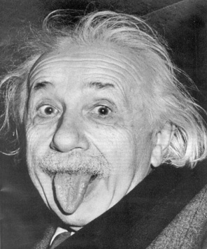
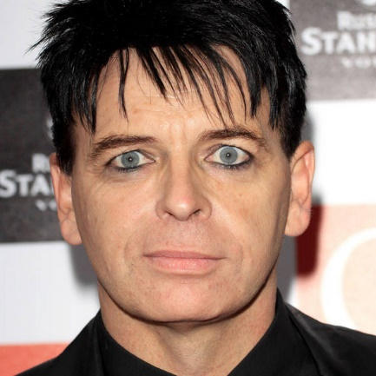
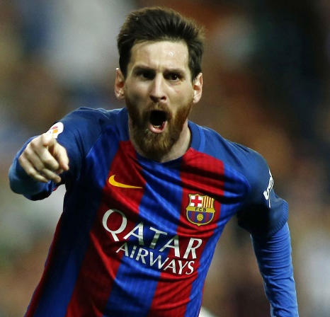
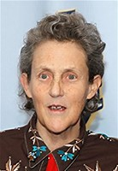

Who do you know?
Dan Aykroyd
Chris Packham
Albert Einstein
Peter Sellers
Daryl Hannah
Bill Gates
Gary Numan
Lionel Messi
Temple Grandin
Notes:
Behaviour strange, spectacular, sometimes moving, sometimes funny
Mechanical behaviour is funny
Typically the symptoms of autism are not physically visible; there is usually nothing about how a person with ASD looks
that sets him/her apart from other people. However,
people with autism may communicate, interact, behave, and learn in ways that are
different from most people.
Chris Packham- recent documentary on BBC- Asperger’s and me Oct 2017

Slide 36

Top Tip 1
Be prepared
Notes:
Going to look at five top tips
Remember these and implement in your setting

Slide 37
Top Tip 2
Be Visual
Notes:
2. Be visual

Slide 38
Top Tip 3
Be clear and concise

Slide 39
Top Tip 4
Create routines

Slide 40
Top Tip 5
Say what you mean and mean what you say!

Slide 41


Ten Things Every Child With Autism Wishes You Knew
By Ellen Notbohm (Future Horizons)
I am first and foremost a child. I have autism. I am not primarily autistic
My sensory perceptions are disordered
Please remember to distinguish between won’t(I choose not to) and can’t(I am not able to)
I am a concrete thinker. This means I interpret language very literally
Please be patient with my limited vocabulary
Because language is so difficult for me, I am very visually oriented
Please focus and build on what I can do rather than what I can’t do
Help me with social interactions
Try to identify what triggers my meltdowns
If you are a family member, please love me unconditionally

